Slide 1

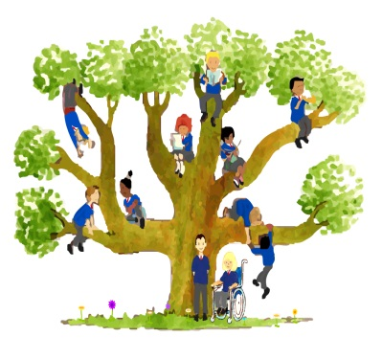

Our Mission Statement
Learn and Grow as God’s Holy People

Slide 2

Meet the Teacher Evening
Year 4
Mrs Woods and Mrs Kirby

Slide 3
Year 4 Daily Routine
8:40 -The gates open
8:50 – Registration
10:30 - Playtime and snack
12:00 -1:00 - Lunchtime
3:20 - Home time
Healthy snacks for break time – piece of fruit.
Water bottle for in class

Slide 4
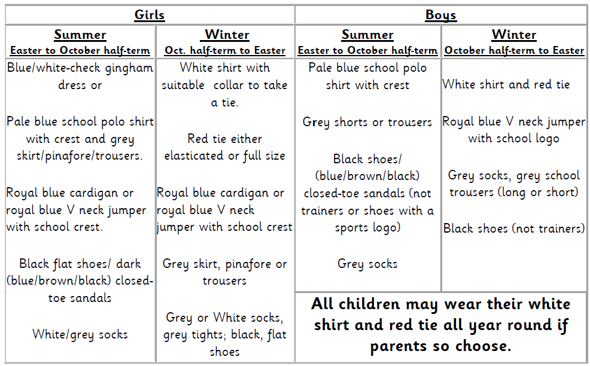
Uniform
After half term all children will be expected to be in Full Winter Uniform.
Our PE days are on Monday and Thursday.
Earrings must be removed on PE days and long hair tied up!

Slide 5
Attendance
It is vital that children attend school every day.
Our school target is 97%.
Also, punctuality is something that has an impact on children’s attainment. Our register closes at 8.50. Please ensure your child is in the classroom by this time, so that they can be registered and are ready to start their lessons.

Slide 6
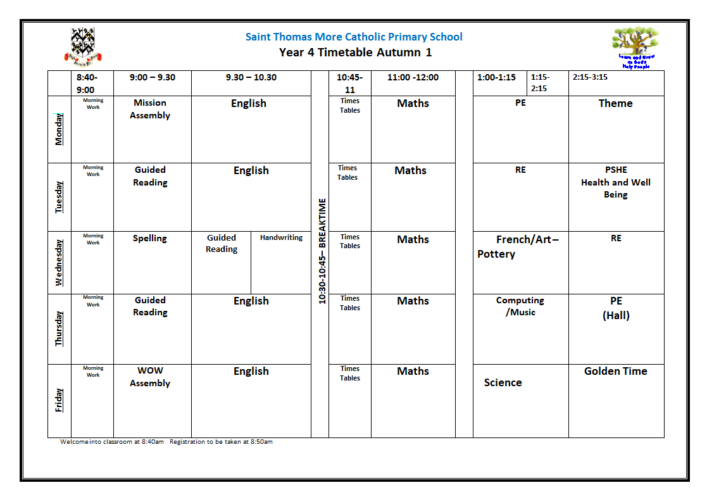

Slide 7

Power maths scheme
Problem solving and reasoning is a big focus.
Number sense & place value
Addition & Subtraction
Multiplication
Fractions & Decimals
Please feel free to have a look at
The example text books on your
tables.
This runs alongside regular fluency
practice and times tables

Slide 8
Writing
Class teachers will monitor writing progress in all curriculum areas over the school year. The children's work becomes the bank of evidence to show which objectives they are able to demonstrate.
Please see the example of writing on your table which shows two pieces of writing that are judged to be expected year 4 writers

Slide 9
Reading
The children are taught reading skills daily in year 4. This may be part of their English lesson, guided reading lesson or during class story time.
Children are given opportunities to read aloud to the class, in partners and within small groups during guided reading. We return to the same text numerous times over the week to develop fluency and comprehension.
To support your child please read your child's reading book with your child on a 1-1 basis at home. We ask that children read a minimum of three times a week.

Slide 10
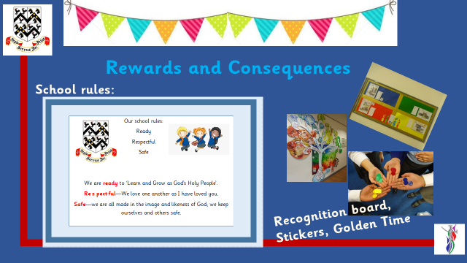

Slide 11
Homework (Wednesday)
Why have homework?
Homework, when used well, can:
· Support the development of an effective partnership between home and school
· Support the learning that takes place at school
· Consolidates and reinforce skills and knowledge of concepts taught
· Provide children with opportunities for independent learning and research
· Encourage children to develop resilience, independence, self-discipline and individual responsibility
· Support parents in understanding the learning expectations for their children
Maths
Spelling
Reading

Slide 12

Year 4 Times Tables
The children are expected to learn all their times tables by the end of the year. We encourage you to allow your children to use TTR.
In the Summer term (June), the Year 4 children will take a National Multiplication check assessment.

Slide 13
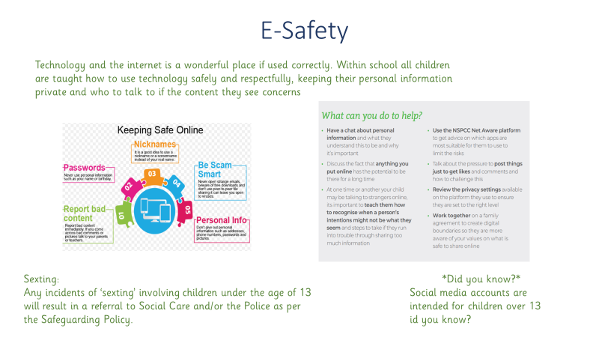
ICT

Slide 14
Dates for your Diary!
Christmas Theatre Visit to watch 'Oliver Twist' in December.
Forest School sessions will be in the Spring Term.
Educational Visit to Conkers in the Spring term - dates TBC

Slide 15

Any questions?

