Slide 1


Meet the Teacher Evening
Year 3
3T - Mrs Chester 3M – Mrs Knight

Slide 2
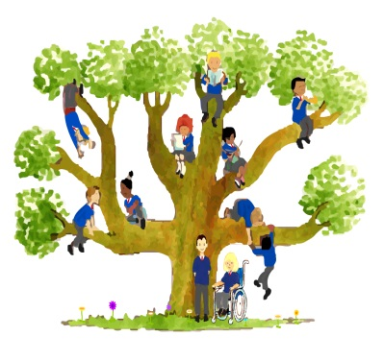
Our Mission Statement
Learn and Grow as God’s Holy People

Slide 3
Year 3 Daily Routine
8:40 -The gates open
8:50 – Registration
10:30 - Playtime and snack
12:00 -1:00 - Lunchtime
3:20 - Home time
Healthy snacks for break time – piece of fruit.
Water bottle for in class – no juice allowed.
Please do not send anything containing nuts. We have a number of children with severe nut allergies in school.

Slide 4

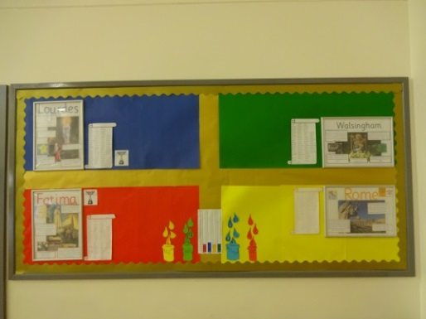
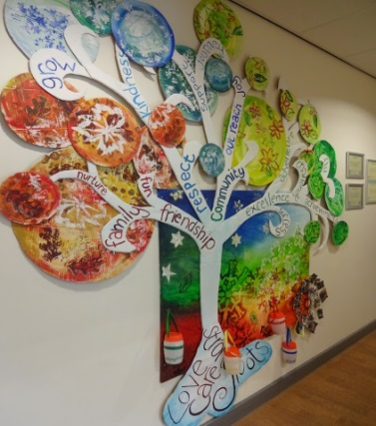
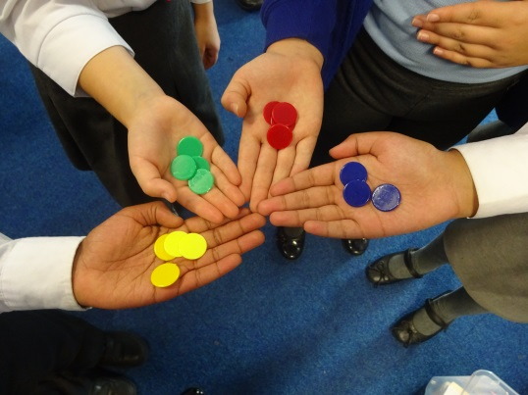
Rewards and Consequences
School rules:
Ready
Respect
Safe
House points
Prizes, Stickers
Classroom consequences

Slide 5
Homework – Hand out on Friday and return the following Thursday
Why have homework?
Homework, when used well, can:
· Support the development of an effective partnership between home and school
· Support the learning that takes place at school
· Consolidates and reinforce skills and knowledge of concepts taught
· Provide children with opportunities for independent learning and research
· Encourage children to develop resilience, independence, self-discipline and individual responsibility
· Support parents in understanding the learning expectations for their children

Slide 6
Homework – Hand out on Friday and return the following Thursday
Homework will be:
Daily reading – at least 10 minutes a day, preferably with an adult. Please sign your child’s diary.
Weekly spellings – following the year 3 spelling curriculum.
Maths: CGP books – children will be told which pages they should complete. These will be highlighted.
Handwriting practise
Times tables practise – Times Tables Rockstars
There will be occasions when a research activity related to our Theme will be set for the children to complete.

Slide 7

Year 3 Expectations and Routines
The children are expected to learn the following times tables by the end of year 3:
2 x, 5x, 10x, 3x, 4x, and 8x.
Regular practise of these facts will help the children with their fluency in other aspects of maths.
In the Summer term of Year 4 children will take a National Multiplication check assessment.
Children can practise their times tables facts using Times Tables Rockstars.
Children will be provided with a password to access the games. This is a fun way for the children to become fluent and more confident.

Slide 8
Year 3 Expectations and Routines
In Maths children will:
Read, write and use numbers up to 1,000.
Add and subtract with 3 digit numbers, using the column method.
Multiply two digit numbers using the times tables that they know.
Add and subtract fractions and identify equivalent fractions.
Develop further understanding when using measurement and time.
Develop further their understanding of 2D and 3D shapes, including identifying right angles.
Present data in tables, bar charts and pictograms.
Further detail can be found on the handout.

Slide 9
Year 3 Expectations and Routines
In writing children will:
Write for different purposes and use different grammatical structures.
Create settings, develop use of ambitious vocabulary and begin to use paragraphs.
Use a range of punctuation including, questions marks, exclamation marks, apostrophes for possession and contraction.
Use conjunctions, adverbs and prepositions.
When spelling use prefixes and suffixes correctly.
Further detail can be found on the handouts, including spelling lists and examples of conjunctions, adverbs and prepositions.

Slide 10
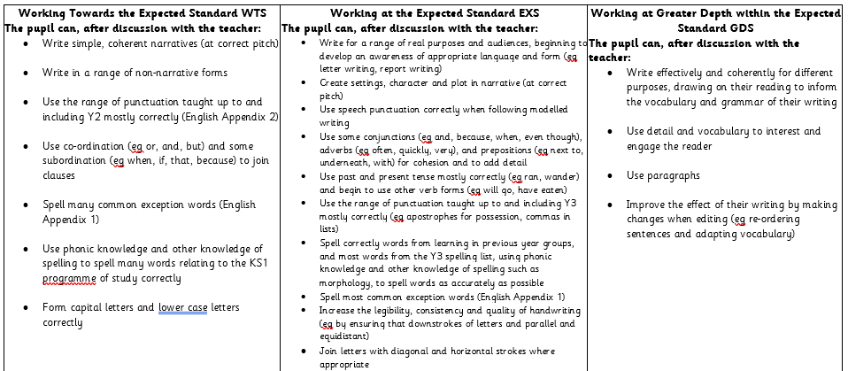

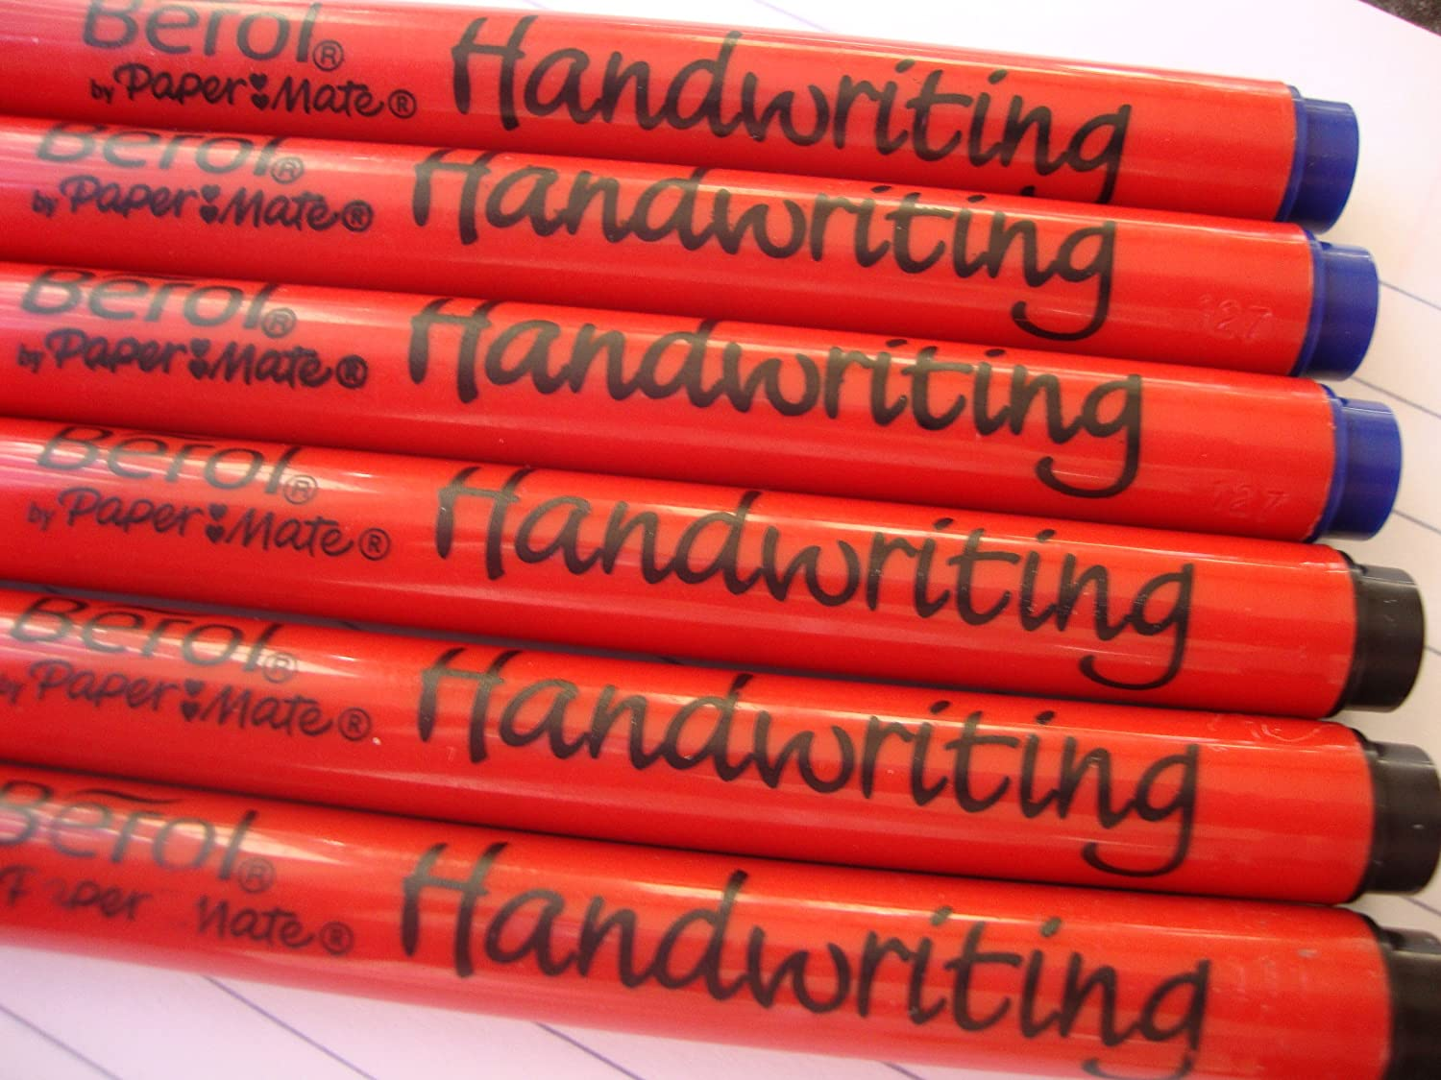
Year 3 Expectations and Routines
Handwriting:
Pen license

Slide 11
Assessment and reporting
Children assessed in Reading, Writing and Mathematics:
Termly PiXL assessments in reading and mathematics
Teacher assessment of writing using standardised age-related expectations criteria. This is an ongoing process.
Regular spelling and Times Tables tests.
Parent’s consultations will take place in Autumn 2 and Spring 2.
Written reports will be shared in Summer 2 with an optional drop in session after that.

Slide 12
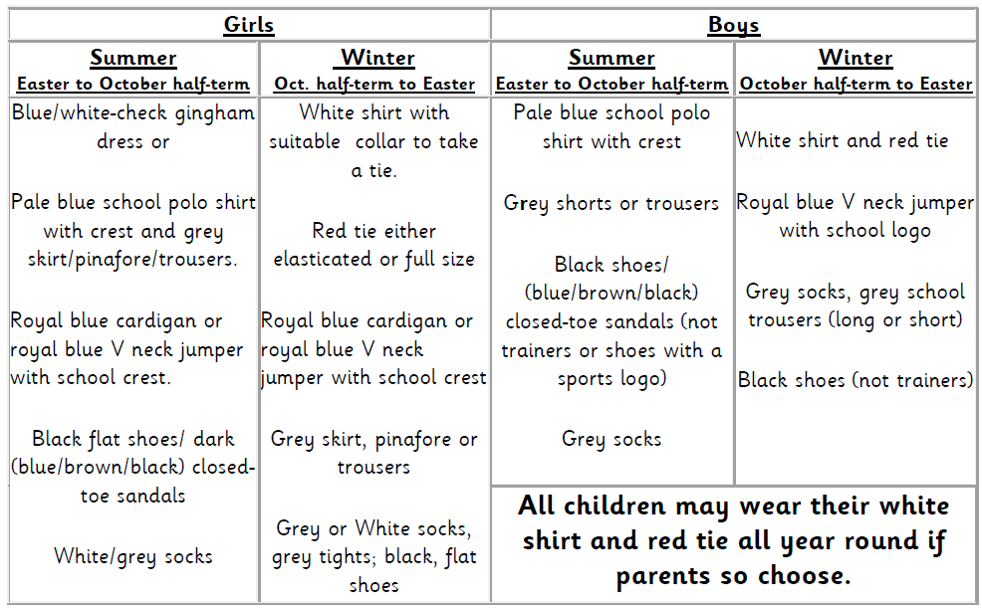
Uniform
After half term all children will be expected to be in Full Winter Uniform.
Long hair must be tied up neatly.

Slide 13
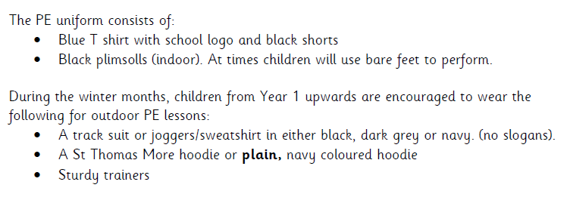
Uniform
Our PE days are on Wednesday and Friday.
Earrings must be removed on PE days and long hair tied up!
Track suits and hoodies should be plain- no football teams/slogans.

Slide 14
Attendance
It is vital that children attend school every day.
Our school target is 97%.
Also, punctuality is something that has an impact on children’s attainment. Our register closes at 8.50. Please ensure your child is in the classroom by this time, so that they can be registered and are ready to start their lessons.

Slide 15
Educational visits
Year 3 will visit the Think Tank in Birmingham, to take part in a Science themed workshop and to explore the exhibits.
We will be going to the Think Tank in March 2024 and the cost will be approximately £18. This covers the cost of the coach, entrance to the Think Tank and the workshop.
Please look out for Parent Mails about this in the future.

Slide 16

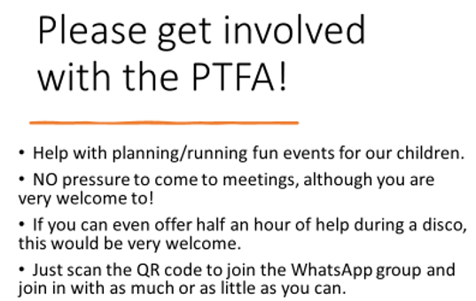

Slide 17

ICT

Slide 18
Dates for your Diary!
Friday 29th September Inset day
Half Term Break
30th October to 5th November

Slide 19


Sacramental preparation
Parents preparation programme dates to be shared.
Sacramental dates
Saturday 27th January – 5.00pm : Mass to pray for Holy Communion.
Saturday 2nd March – 9:15am: Mass followed by Sacrament of First Reconciliation.
Sunday 9th June – 9.00am: Sacrament of First Holy Communion.
Registration handout for those children who will be receiving the sacraments.

Slide 20
How to contact us
If you have any questions during the term, please email school on:
admin@st-thomasmore.coventry.sch.uk
Emails will be responded to as soon as we can. Please bear with us.
Messages can also be given to the adults on the gates in the morning/afternoon.

Slide 21

Any questions?
If you have any questions, we will be here for a few minutes.

