Slide 1




Online Learning
 | Maths | English
Reception | Using everyday language to compare and explore capacities (thenational.academy) | Lesson 31 - Read longer words - YouTube
Year 1 | To recognise, name and describe 3D shapes (thenational.academy) | To listen and respond to a set of instructions (thenational.academy)
Year 2 | To use the language of position (thenational.academy) To use the language of position, direction and movement (Part 1) (thenational.academy) | To listen and respond to a story (thenational.academy)
Year 3 | Applying addition and subtraction strategies within context (thenational.academy) | To explore simple sentences (thenational.academy) To explore compound sentences (thenational.academy)
Year 4 | Applying and consolidating: Reasoning with 4-digit numbers (thenational.academy) | To explore simple and compound sentences (thenational.academy)
Year 5 | Solving problems involving place value and rounding (thenational.academy) | To explore complex sentences (thenational.academy)
Year 6 | Order of operations (thenational.academy) Consolidating order of operations (thenational.academy) | To explore the functions of a colon (thenational.academy)

Slide 2
KS2 Wider Curriculum Please choose a TES Live Lesson to join…
Tes Live Lesson with The Royal Mint Museum Led by Amy Williams, Learning and Education Manager at The Royal Mint Museum, this lesson explores the history and heritage of coins around the world. You will learn about the design and production of coins and see the very first coins to feature King Charles III. With interactive activities and video clips of other children sharing their ideas, you will look at coins in a completely different way. Tes Live lesson with The Royal Mint Museum - YouTube | Tes Live Lesson with Disney Led by Disney Theatrical Teaching Artists Tori and Ben, complete a musical theatre lesson based on one of Frozen's best known songs Fixer Upper, taught from the Royal Theatre, Drury Lane, London. You will learn the choreography and singing parts to Fixer Upper. Tes Live Lesson with Disney - YouTube
Tes Live Lesson with The Royal Horticultural Society Visit RHS Harlow Carr Garden to explore the plants and how they are adapted to suit their environment. RHS Education Officers, Ruth and Janet, will lead you on an exciting journey of discovery by getting up close to the plants in two completely different environments: alpine and sub-tropical. Through activities, interviews and role play we’ll investigate how the plants have adapted to these extreme environments and how that helps them survive and evolve. Tes Live Lesson with The Royal Horticultural Society | Tes | Tes Live Lesson with Childnet Led by online safety charity Childnet, this lesson explores the important topic of online bullying. You will be introduced to a series of scenarios and asked to think about what you would do in each one. Children from St Joseph's Catholic Primary School share their responses and Amy Lockwood, Education Manager at Childnet, shares some top tips and advice that we can all follow to help stop online bullying. Tes Live Lesson with Childnet - YouTube

Slide 3
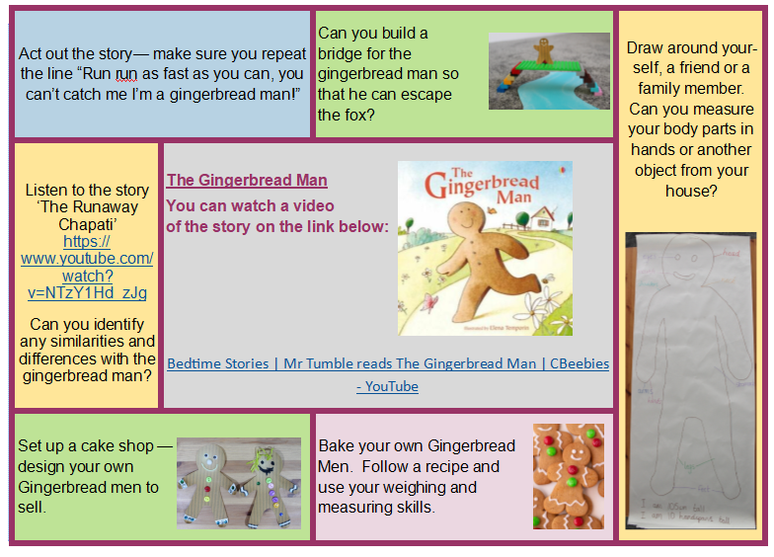
EYFS Book Talk

Slide 4
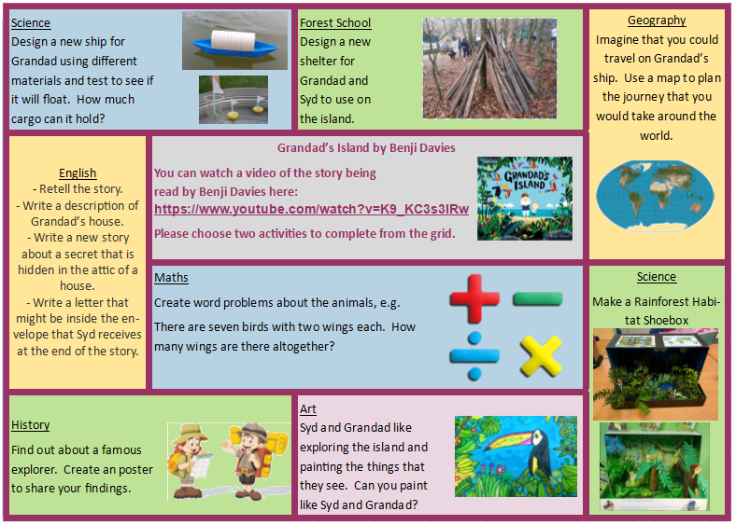
Year 1/2 Book Talk
Please listen to the story ‘Grandad’s Island’ by Benji Davies and choose a linked activity from below to complete.
Benji Davies reads Grandad's Island - YouTube

