Slide 1
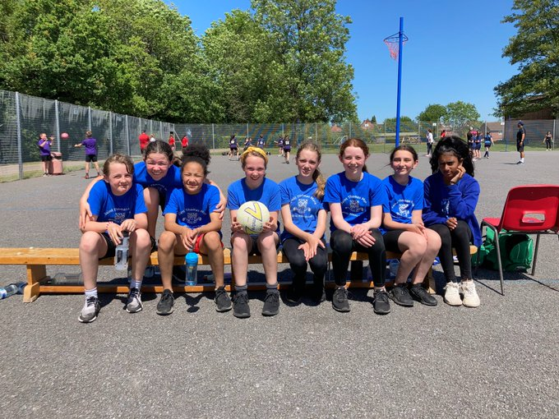
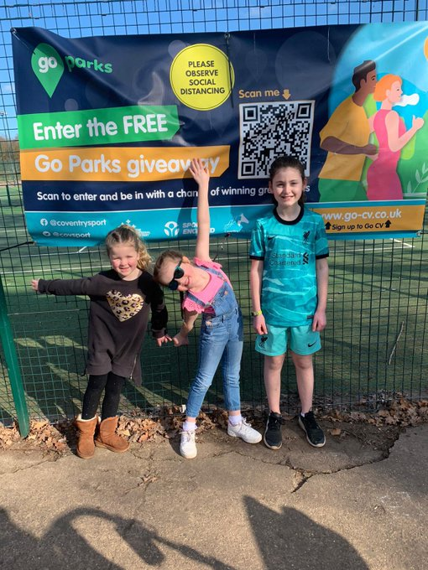
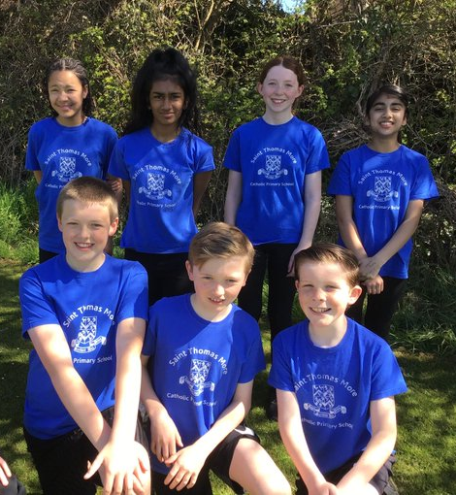
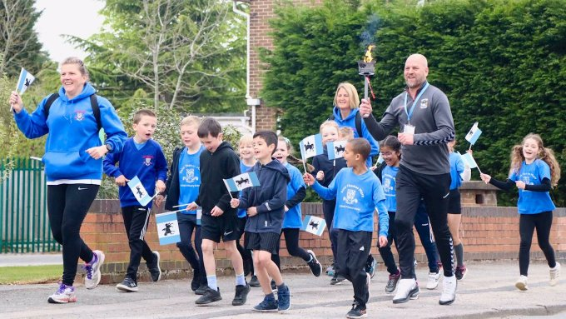
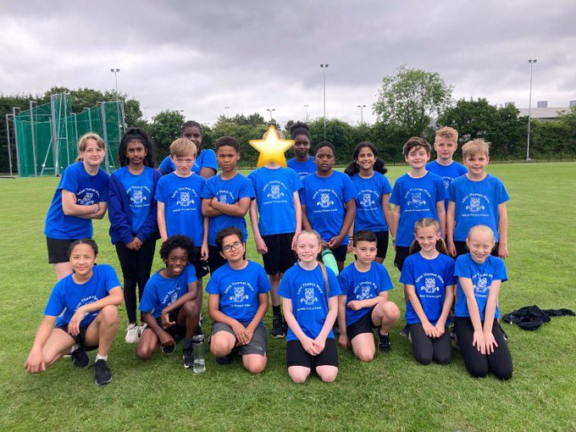

Saint Thomas More Catholic Primary School
Sports Funding Impact and Analysis Statement
Following pages are tables showing impact of Government Sports Funding for 2021- 2022

Slide 2
Background
The Government has provided funding until 2021-22 to provide new, substantial primary school sport funding. This funding is being jointly provided by the Department for Education, Health and Culture, Media and Sport, and will see money going directly to primary school Headteachers to spend on improving the quality of sport and PE for all their children.
The sport funding can only be spent on sport and PE provision in schools. OFSTED will play a significant role in ensuring that schools target this funding in areas which will lead to clear outcomes in raising standards and opportunities in PE and school sport for all children throughout the Primary Phase. All schools receive a lump sum of £16,000 plus an additional £10 per pupil. We are proud of the PE curriculum and sporting opportunities that we have on offer at Saint Thomas More Catholic Primary School. We believe that the purpose of Physical Education is to inspire and motivate all children to be active in their lives, enabling them to become physically confident. The importance of living a healthy lifestyle and taking regular exercise needs to be encouraged, alongside the teaching of key fundamental skills. We believe that children should have opportunities to apply the skills they have learnt in competitive situations, either within teams or individually. As a result, key values, including team work, resilience, determination and fair play, can be taught and promoted in an active way. We believe these key values are vital for pupils’ development because lots of these are transferable skills, which can be applied to wider life experiences. Furthermore, we believe that PE plays a fundamental role in educating the whole student. Research supports the importance of movement in educating both mind and body. It also helps the children to make informed choices and understand the value of leading a physically active lifestyle. The benefits of physical education can affect both academic learning and physical activity patterns. The healthy, physically active child is more likely to be academically motivated, alert and successful. In the pre-school and primary years, active play may be positively related to motor abilities and cognitive development. We believe that quality physical education teaching is essential in developing motor skills, physical fitness and understanding of concepts that foster lifelong healthy lifestyles.
At Saint Thomas More Catholic Primary School, we ensure that the children receive the highest quality of teaching during their PE sessions. We strive to improve children’s ability and skills in sport as well as having a significant impact on the overall fitness and well-being of the children. We aim for all children to develop positive attitudes towards physical activity ensuring all lessons are accessible by providing a range of different activities to challenge every pupil. We believe in challenging ourselves to always strive to be our best and use our God-given talents to their full potential; we endeavour to instil this personal challenge in our children.

Slide 3
Key achievements to date: | Areas for further improvement and baseline evidence of need:
o Raised profile of sport across the school o Increased equipment to support active lifestyle during lunchtime and breaks o Train sports leaders to support class lessons and lunchtime activities o Increased participation in local sports | o Further develop the links with local grassroots clubs Make further links within PE across the school and within the Holy Cross MAT o Embed the use of PE passport to support planning and assessment of PE across the school
Meeting national curriculum requirements for swimming and water safety | Please complete all of the below:
What percentage of your current Year 6 cohort swim competently, confidently and proficiently over a distance of at least 25 metres? N.B. Even though your children may swim in another year please report on their attainment on leaving primary school. | 42%
What percentage of your current Year 6 cohort use a range of strokes effectively [for example, front crawl, backstroke and breaststroke? | 27%
What percentage of your current Year 6 cohort perform safe self-rescue in different water-based situations? | 96%
Schools can choose to use the Primary PE and Sport Premium to provide additional provision for swimming, but this must be for activity over and above the national curriculum requirements. Have you used it in this way? Yes/No | Those children who were already at expected for the National Curriculum received additional swimming instruction in water safety and had water games instruction beyond the cucrriculum.

Slide 4
Academic Year: 2021/22 | Total fund allocated: XXXXXXX | Date Updated:
Key indicator 1: The engagement of all pupils in regular physical activity – Chief Medical Officer guidelines recommend that primary school children undertake at least 30 minutes of physical activity a day in school |  |  |  | Percentage of total allocation:
 |  |  |  | %
School focus with clarity on intended impact on pupils: | Actions to achieve: | Funding allocated: | Evidence and impact: | Sustainability and suggested next steps:
o To provide more focus on physical activity to ensure children increase their activity to at least 30 minutes a day. | PE staff to deliver sessions of sport over lunchtime. Activities will be varied and determined through pupil voice to appeal to all pupils. Equipment to deliver high-quality sessions to be provided. | £780 | The objective is for 75% of pupils within each year group to have participated in sporting activities during lunchtime over a sustained period. | Review timetable for September going forward

Slide 5
Academic Year: 2021/22 | Total fund allocated: £ | Date Updated:
Key indicator 1: The engagement of all pupils in regular physical activity – Chief Medical Officer guidelines recommend that primary school children undertake at least 30 minutes of physical activity a day in school |  |  |  | Percentage of total allocation:
 |  |  |  | %
School focus with clarity on intended impact on pupils: | Actions to achieve: | Funding allocated: | Evidence and impact: | Sustainability and suggested next steps:
o Further increase the quality of provision and practice of sport across the school. | Continue to run a range of multi-sport activities alongside sports training for school teams. o All pupils in KS2 to undertake the fitness test to record baseline fitness measurement followed by mid and end of year assessments. | £2963 £500 | o Staff/Pupil feedback to be carried out to see if there has been a positive experience and impact measurable through performance related targets. Part of the PE curriculum lessons | Continue with provision

Slide 6
Key indicator 2: The profile of PESSPA being raised across the school as a tool for whole school improvement |  |  | Percentage of total allocation:
 |  |  | %
School focus with clarity on intended impact on pupils: | Actions to achieve: | Funding allocated: | Evidence and impact: | Sustainability and suggested next steps:
o Profile of sport to be enhanced across the school through more effective communication. Resources to be available to all staff to teach PE Storage for lunchtime equipment | o Regular updating of school newsletters, reports in assemblies, sports notice boards, certificates, medal and trophies Social media updates, twitter and Facebook Shared S drive is updated regularly with lesson plans and schemes of work for each year group. Equipment and trollies ordered and stored in old PE store for break and lunchtimes | £2345 £205 | Success of the school sports celebrated. Tweets are being read and retweeted, shared and liked Staff are more confident in delivering the PE curriculum. Break /lunchtime equipment for children to use = more active and playing together. Skills improving | Continue with current communication Positive feedback from parents Timetable CPD for staff recent audit of skills Equipment to be checked at the end of the year and replaced/reused

Slide 7
Key indicator 3: Increased confidence, knowledge and skills of all staff in teaching PE and sport |  |  | Percentage of total allocation:
 |  |  | %
School focus with clarity on intended impact on pupils: | Actions to achieve: | Funding allocated: | Evidence and impact: | Sustainability and suggested next steps:
To improve teaching and learning of PE and help support monitoring of pupil’s physical activity levels. o All staff to be offered CPD in different areas of the PE curriculum and upskilled termly by PE lead and sports coach | o Ensure that PE Lead is well-supported throughout the year through half termly meetings, tailored support and liaising with outside providers. o PE Lead to attend meetings and complete follow up actions Staff to attend CPD Build confidence in teaching PE curriculum Lesson plans and resources available for the delivery of the lessons | £10845 | o Drop in lesson observations by PE Lead & SLT will take place to evidence the quality of PE lessons. o Pupil feedback will be gathered to view if there has been positives and all pupils enjoy the lessons. CT to attend the PE lessons and observe and deliver the whole lesson each half term/PE unit Continue throughout the year. Staff delivering lessons confidently | Continue to monitor lessons Feed back through school council meetings CT or new staff to receive CPD from September 2022/ Top up support for CT PE timetable to be arranged

Slide 8
Key indicator 4: Broader experience of a range of sports and activities offered to all pupils |  |  | Percentage of total allocation:
 |  |  | %
School focus with clarity on intended impact on pupils: | Actions to achieve: | Funding allocated: | Evidence and impact: | Sustainability and suggested next steps:
o Further increase the offer of a wide range of activities within the school day to increase participation of pupils. Badminton Outdoor Learning o Provide high-quality coaching to support the develop of key sports across the year. | o Specific equipment to be purchased to support wide range of activities throughout the school day Contact local clubs Coventry City Football Coventry Rugby Wasps Rugby Coventry Bears Rugby League Wasps Netball Events and community opportunities for the school to get involved | £7472 | With the support of purchasing of additional equipment, this will help benefit more pupils to be active and engaged in physical activity across the school. Pupils will have opportunities to be involved with local clubs and events | Review engagement of the activities by pupils during lessons and after school clubs. Feedback from pupils. Continue into 2022

Slide 9
Key indicator 5: Increased participation in competitive sport |  |  | Percentage of total allocation:
 |  |  | %
School focus with clarity on intended impact on pupils: | Actions to achieve: | Funding allocated: | Evidence and impact: | Sustainability and suggested next steps:
o Increased participation in competitive sports. Local Authority, Catholic Sport Association, The Romero Catholic Academy and local primary school events. o Facilitate access of sporting opportunities across the city. | o Enter Coventry Catholic Primary School Sports Association. o Enter Coventry Schools Games Primary events o Hire minibus to provide the required transport to attend sporting events and swimming programme | £100 £60 £280 | o School will aim to achieve 100% attendance within all Coventry Catholic sports events across the year. o To increase overall standing in The Donnell Kenny from the previous year. o For a greater percentage of pupils to participate within the School Games competitions. | Continue with competitions, have had success this year in netball and football. Target after school clubs for pupils to practice and train for the different competitions.

